Slide 1
Modules and packages
Modules:
A file containing a set of functions that can be include in your application.
Create a Module
To create a module just save the code you want in a file with the file extension.py
Help(“modules”) and 200 + standard lib
Predefined modules
Math
Calender
Decimal
Datetime
Time
Advanced
Numpy
Pandas
Matplolib.pytlot
Seaborn
Sklearn
Tensorflow
Keras
thenao

Slide 2
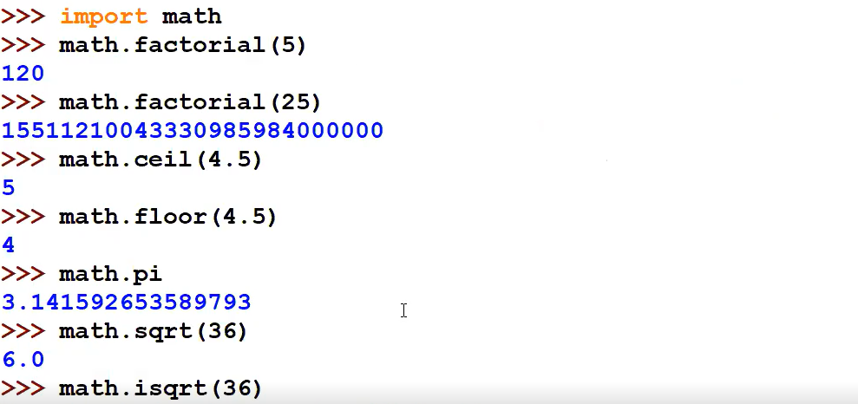

Slide 3

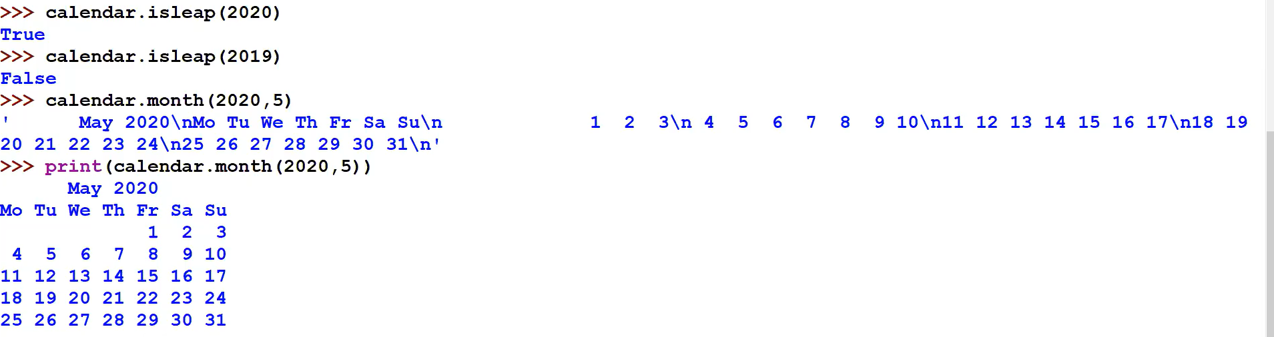
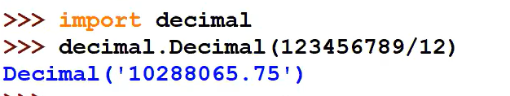

Slide 4
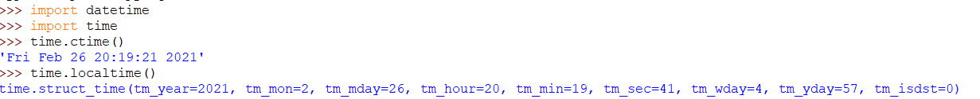
import time result = time.localtime(1545925769)
print("result:", result)
print("\nyear:", result.tm_year)
print("tm_hour:", result.tm_hour)
named_tuple = time.localtime() # get struct_time
time_string = time.strftime("%m/%d/%Y, %H:%M:%S", named_tuple) print(time_string)
%Y - year [0001,..., 2018, 2019,..., 9999]
%m - month [01, 02, ..., 11, 12]
%d - day [01, 02, ..., 30, 31]
%H - hour [00, 01, ..., 22, 23
%M - minutes [00, 01, ..., 58, 59]
%S - second [00, 01, ..., 58, 61]
import time
c=1+2
print(c)
time.sleep(10)
c=2-1
print(c)

Slide 5
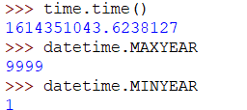
import datetime x = datetime.datetime.now() print(x)
print(x.year) print(x.strftime("%A"))
Creating Date Objects
x = datetime.datetime(2020, 5, 17) print(x)
The method is called strftime(), and takes one parameter, format, to specify the format of the returned string
x = datetime.datetime(2018, 6, 1) print(x.strftime("%B"))

Slide 7
Directive | Description | Example | Try it
%a | Weekday, short version | Wed | Try it »
%A | Weekday, full version | Wednesday | Try it »
%w | Weekday as a number 0-6, 0 is Sunday | 3 | Try it »
%d | Day of month 01-31 | 31 | Try it »
%b | Month name, short version | Dec | Try it »
%B | Month name, full version | December | Try it »
%m | Month as a number 01-12 | 12 | Try it »
%y | Year, short version, without century | 18 | Try it »
%Y | Year, full version | 2018 | Try it »
%H | Hour 00-23 | 17 | Try it »
%I | Hour 00-12 | 05 | Try it »
%p | AM/PM | PM | Try it »
%M | Minute 00-59 | 41 | Try it »
%S | Second 00-59 | 08 | Try it »
%f | Microsecond 000000-999999 | 548513 | Try it »
%z | UTC offset | +0100
%Z | Timezone | CST
%j | Day number of year 001-366 | 365 | Try it »
%U | Week number of year, Sunday as the first day of week, 00-53 | 52 | Try it »
%W | Week number of year, Monday as the first day of week, 00-53 | 52 | Try it »
%c | Local version of date and time | Mon Dec 31 17:41:00 2018 | Try it »
%x | Local version of date | 12/31/18 | Try it »
%X | Local version of time | 17:41:00 | Try it »
%% | A % character | % | Try it »
%G | ISO 8601 year | 2018 | Try it »
%u | ISO 8601 weekday (1-7) | 1 | Try it »
%V | ISO 8601 weeknumber (01-53) | 01

Slide 8
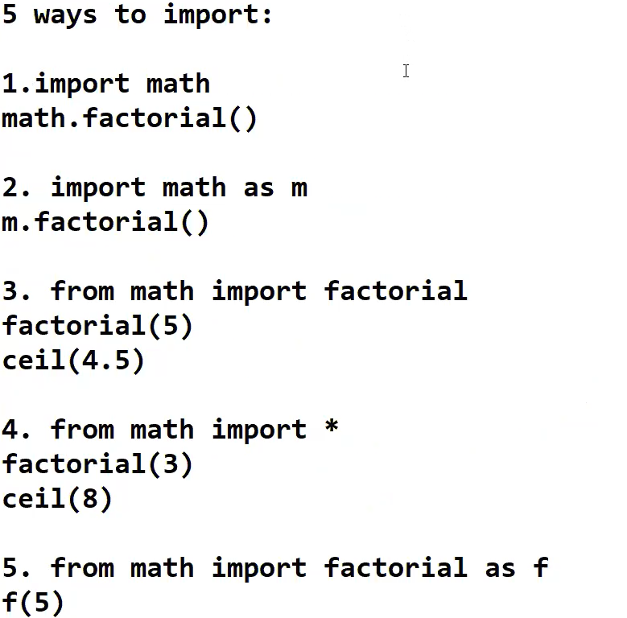

Slide 9
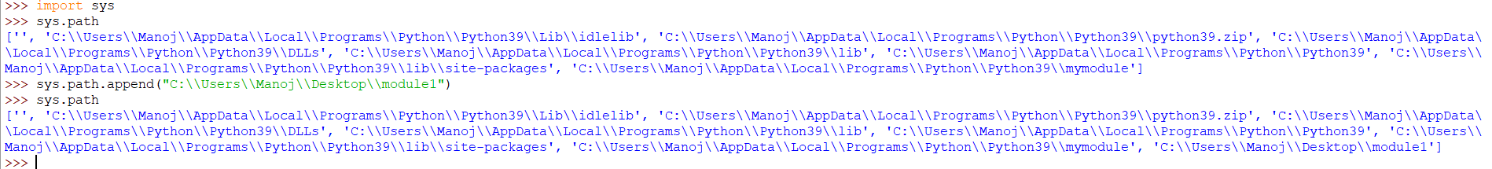
3Locations:
PythPython installed location
on lib
Site package
To set user define path in other location we have to set location

Slide 10
Mymodule.py file in any folder in particular location
def call():
print("I am function1 in mymodule...")
def call1():
print("I am function2 in mymodule...")
Include this module in another python pgm
Save the following pgm in the same folder which contain module file
import mymodule
mymodule.call()
mymodule.call1()
Now run the program

Slide 11
Packages
It is folder that contains more than one python file
Eg:
Create pack1 folder in python folder
Pack1 -> mypack→ mymodule,mymodule2,mymodule3, __init__.py
mymodule.py
def call1():
print("I am function1 in mymodule...")
def call2():
print("I am function2 in mymodule...")

Slide 12
mymodule1.py
def call3():
print("I am function1 in mymodule...")
def call4():
print("I am function2 in mymodule...")
mymodule2.py
def call5():
print("I am function1 in mymodule...")
def call6():
print("I am function2 in mymodule...")

Slide 13
__init__.py file
import sys
sys.path.append("C:\\Users\\apollo\\Desktop\\pack1")
from mypack import mymodule,mymodule1
Save all these file in package1 folder
Now run the __init__ file
After run of init file then only the package is ready to available for importing in another python program
Now eg:
Another file sample.py implements package1
import sys
sys.path.append("C:\\Users\\apollo\\Desktop\\pack1")
import mypack
mypack.mymodule.call1()
or
import sys
sys.path.append("C:\\Users\\apollo\\Desktop\\pack1")
from mypack import mymodule
mymodule.call1()

Slide 14
Task1
Program to display given year and month(2000,January)
Task 2
Program for count a leap days for 2000 to 2020
Task3:
Find count of leap year of given list using module concepts
Task4
Create own program for module concepts
Task 5
Create own program for packages concepts

Slide 15
Task1
import calender
calendar.month(2000,1)
Task2
Calendar.leapdays(2000,2020)
C:\Users\Your Name\AppData\Local\Programs\Python\Python36-32\Scripts>pip install camelcase

